Slide 1


Mini Project from Course DataCamp “netflix movie investigation by duration”
Netflix! What started in 1997 as a DVD rental service has since exploded into the largest entertainment/media company by market capitalization, boasting over 200 million subscribers as of January 2021. Now I will explore duration in netflix.!

Slide 2
Data sheet:
Anlysis use python (pandas) and visualization (matplotlip)
Datasheet:
Tabular data (make some dictionary for simple visualization)
Data Netflix (7787 data)
Show id
Type
Title
Director
Cast
Country
Data_added
Release year
Duration
Description
Genre

Slide 3
Flow for discussion:
Visualization with method:
Data Driven
Deklaratif
Anlysisi Data
with pandas
Visualization
with matplotlip
Data preaperation
Summary anlysis

Slide 4
Simple Analysis with
data tabular

Slide 5
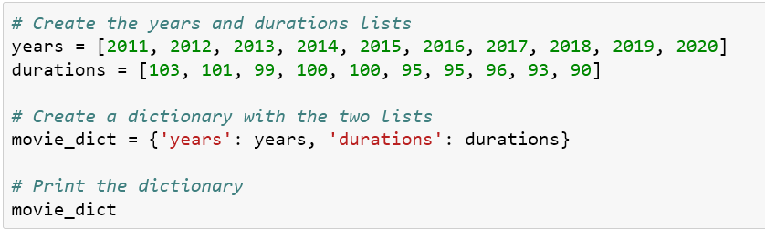
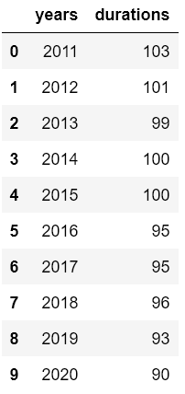
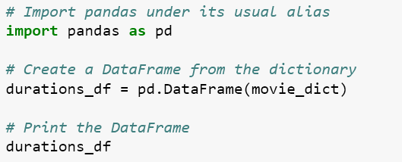
First make some data tabular for simple anlysis
Make data tabular to
dictionary
Convert Dict to
dataframe
Result

Slide 6
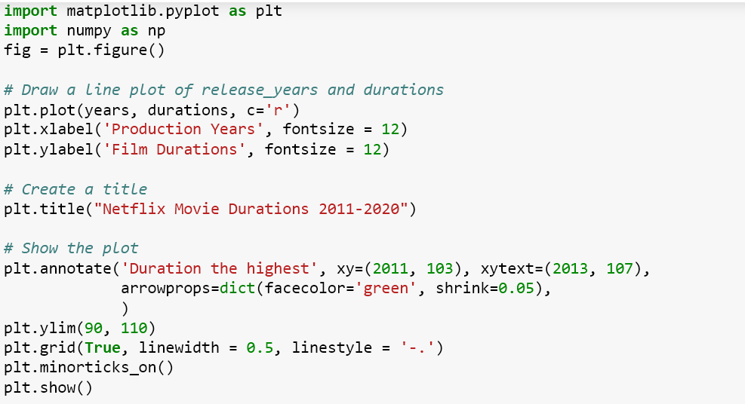
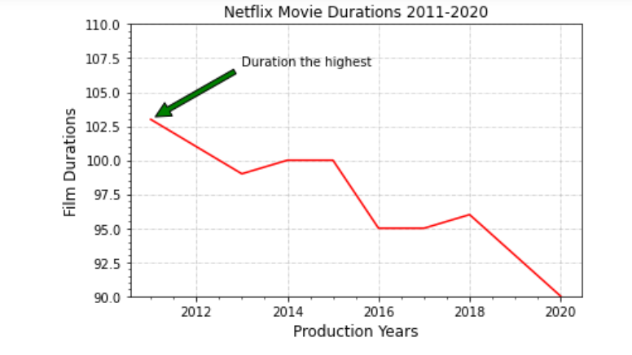
Make Visualization use matplotlip
Coding for visualization
Result
Short Summary :
The highest duration on netflix is 103 minutes in 2011 years and you can see from 10 years the duration of the movie has
decreased.

Slide 7
Simple Analysis with
data Netflix

Slide 8
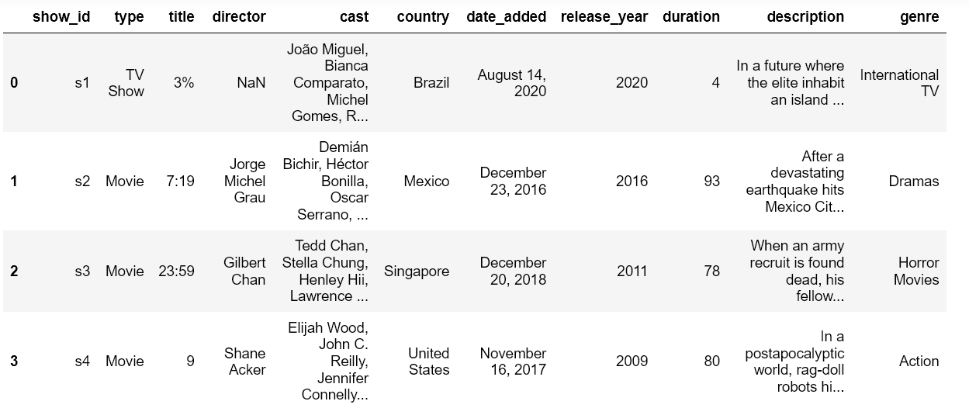
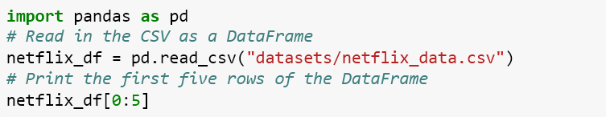
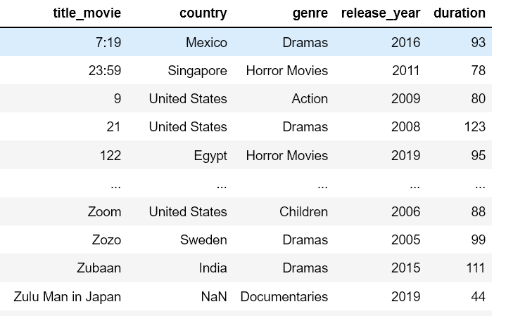
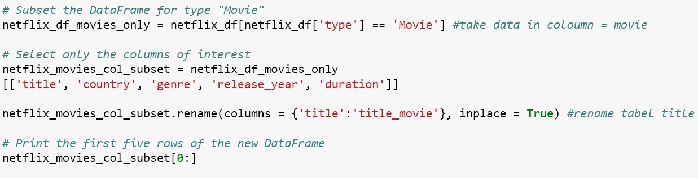
First Upload data and filtering
Import datasheet netflix
Filtering data : I just need some table data for simple anlysis (I use title in dict table just movie category)

Slide 9
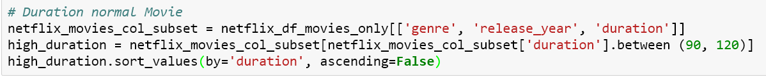
Filtering Data
I juts compare data category duration normal movie (90 – 120 minutes) and short movie (10 -30 minutes
Question 1 > How much data for normal duration and short duration in dataframe?
My answer :
-) I’m obtain for normal duration = 2713 data and short duration = 116 data

Slide 10
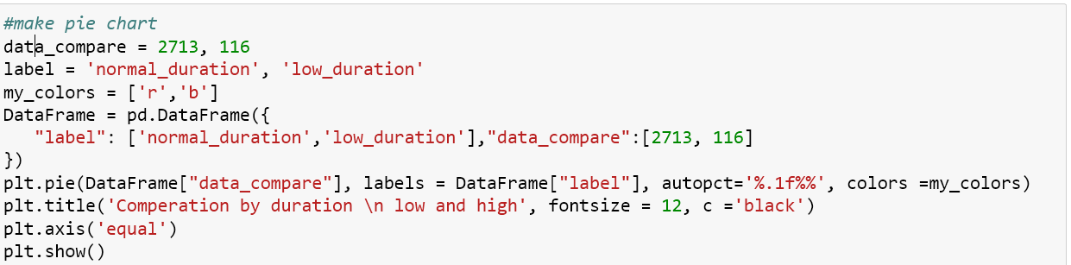
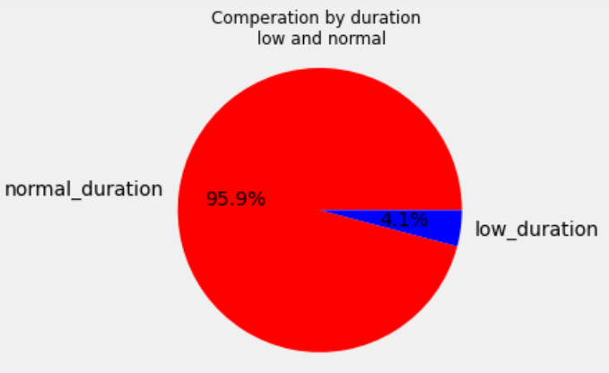
Visualization comperation data duration
Make pie chart :
Question 2 > How much proportion data in duration normal and low?
My answer :
-) so that I know what percentage is the proportion of the data.
I’m obtain data normal_duration have proportion is 95.9 % and
low _duration is 4.1 %. We get the highest proportion from data is
Normal Duration. Next we will search category movie in the highest
Proportion data

Slide 11
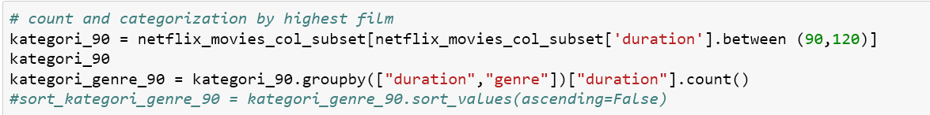
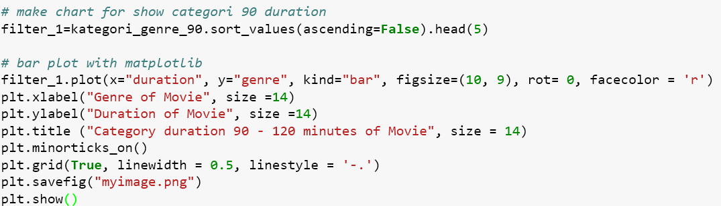
Categorical data duration normal
Make variable for make barplot:
Make code visualization barplot:

Slide 12
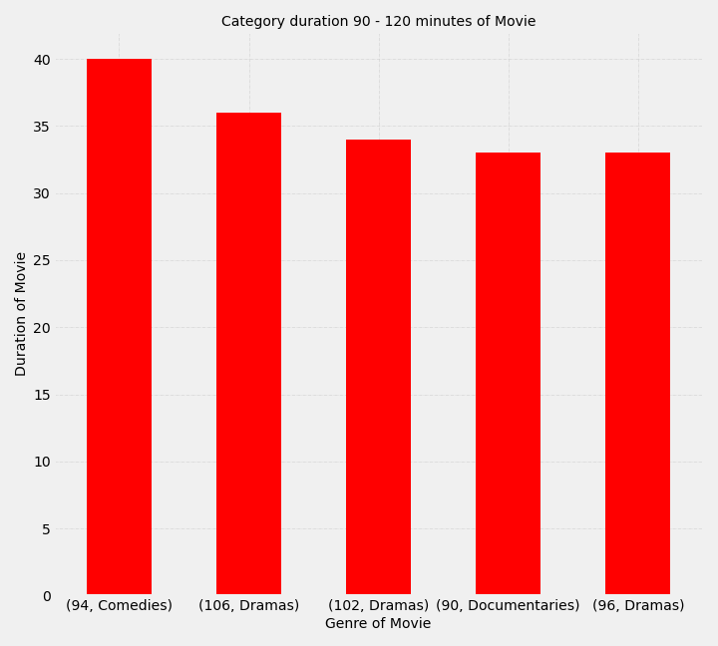
Interpretation:
Question 3 >
which category has a duration between 90 -120 minutes ?
My Answer :
I just look the bigger 5 from this data and I get the first category is comedies in 94 minute, as much 40 data.

Slide 13
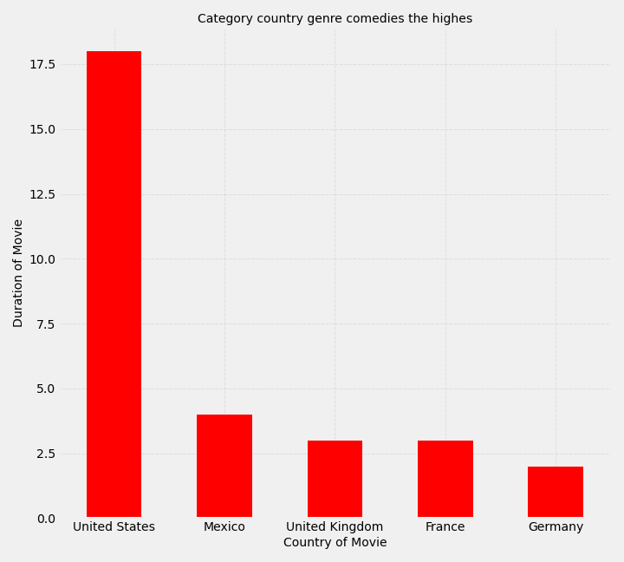
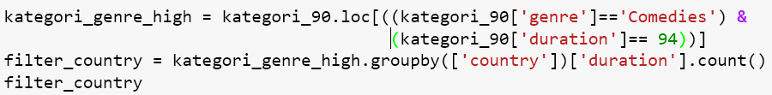
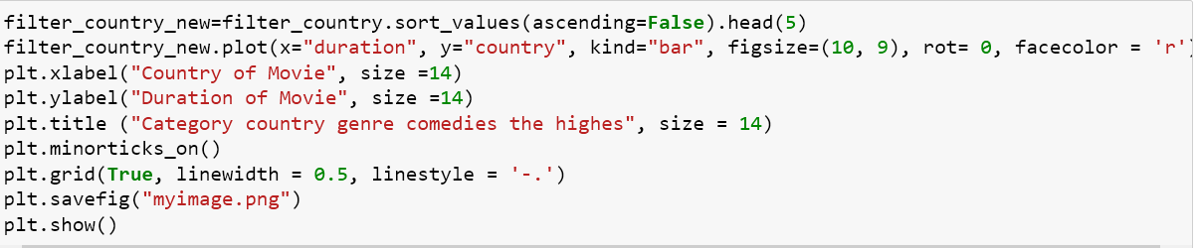
Interpretation:
This Code search where data the highest before
Question 4 >
which country has a category comedies and duration?
My Answer :
I look United States is the highest (18 data from 40 data)

Slide 14
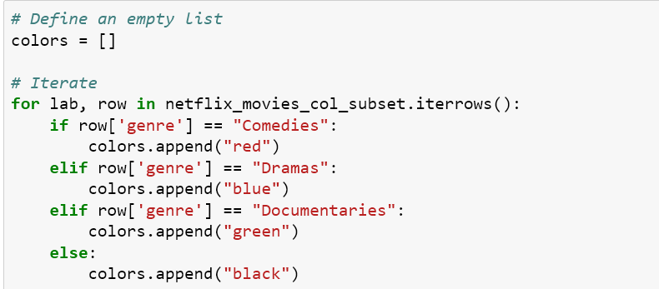
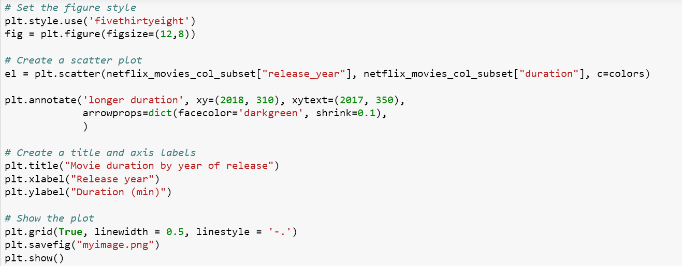
Spare data
Previously we have obtained data from the big 5 movie categories, now we see how the data is distributed using a scatter plot:
First make color different for the big 3 genre in below (comedies, dramas, documentaries):
second make scatterplot visualization

Slide 15
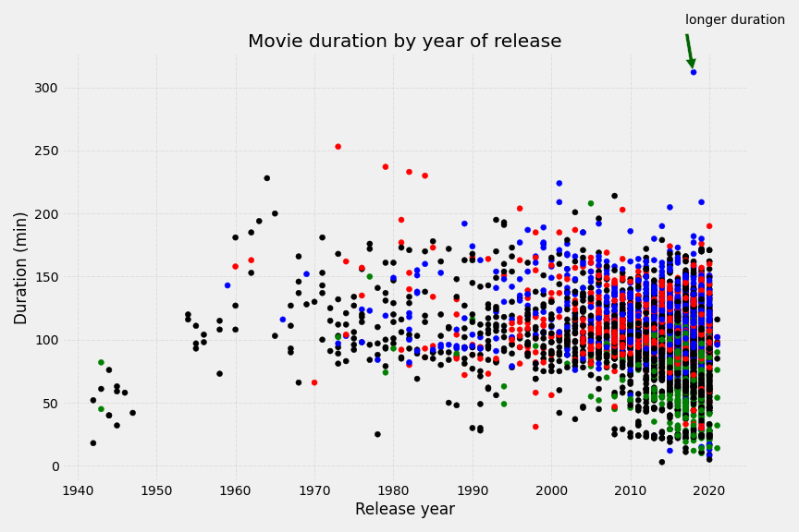
Result

Slide 16
Summary:
From data tabular, which had the highest duration in 2011 of 103 minutes and from 2011 to 2020 the duration is decreasing
From data Netflix Proportion between normal duration and low duration is is (95.9 : 4.1) %.
The bigger normal duration is genre comedies in United State
Visualization scatter plot showing is the biggest duration data is in dramas genre (330 minutes in 2018 years) and spare data in range 90 – 120 minutes (category normal_duration) minutes rerate in comedies and dramas genre. But category low_duration in range 10 -30 minutes is documenteris genre.

Slide 17
Thank you

